Slide 1

UCLA Health
Business Problem
UCLA Health's radiology department faced challenges in coordinating team members effectively. Identifying which physicians were available for specific subspecialties was time-consuming, often causing delays in urgent decisions. The tools they used lacked integration and real-time updates, making communication fragmented and inefficient. There was no centralized system to quickly access contact information or save frequently contacted physicians, which added to the workload and slowed down operations. These issues impacted productivity and the ability to deliver timely care.
What We Did
To address these challenges, we developed Radiology Live, a custom Microsoft Teams bot designed to streamline the radiology department’s workflow. The bot provides real-time updates on physician availability by subspecialty and integrates seamlessly with Microsoft Teams to enable instant communication through chat, call, or email. It features a personalized "My List" option for saving frequently contacted physicians, making access quicker and easier. Built using Azure services, M365 Groups, and SharePoint, the solution centralized data management and enhanced team coordination. By simplifying workflows and reducing delays, RadiologyLive improved communication efficiency and overall productivity in the department.

Slide 2

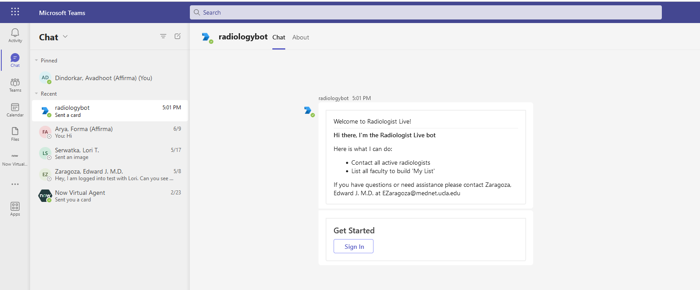
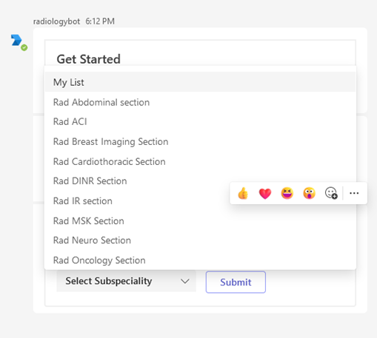
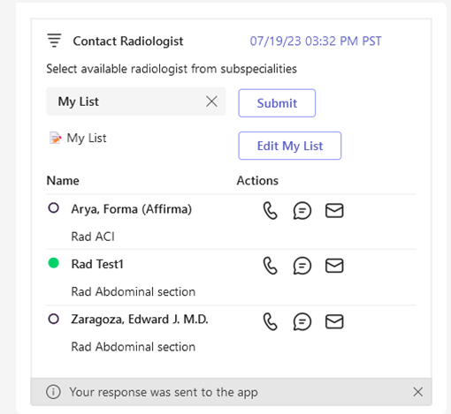
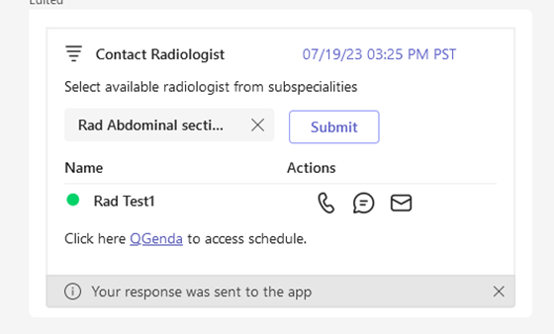
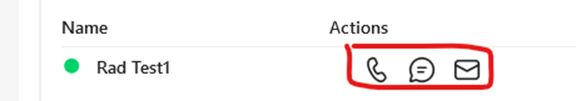
UCLA Health

